Slide 1
Navigating the Invoice Application (Grants Application) for L4GA
A How To Guide for L4GA Reimbursement
Kimberly NeSmith
Principal
Pelham City Middle School
knesmith@pelham-city.k12.ga.us / (229) 294-6063

Slide 2
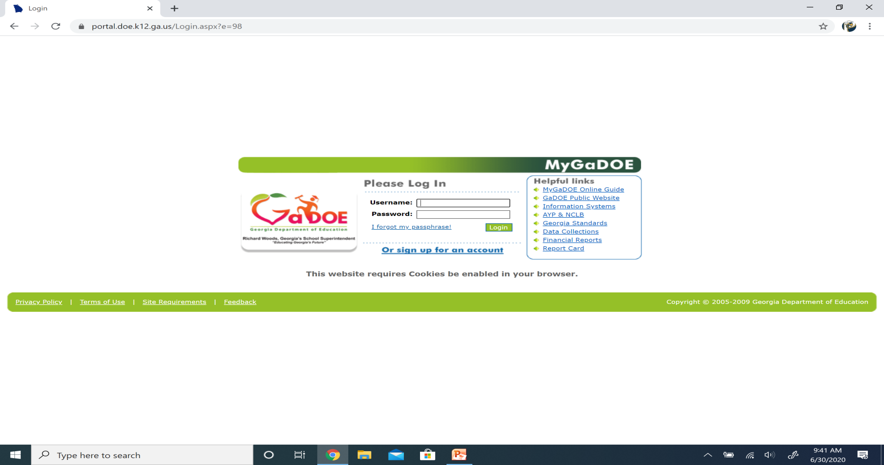
Step 1: Log in to MyGaDOE Portal (portal.doe.k12.ga.us)
If you aren’t sure about your credentials or don’t have any, you’ll need to have your district’s portal security person request access for you from GaDOE. (This is probably your Finance Director or IT Director.)

Slide 3
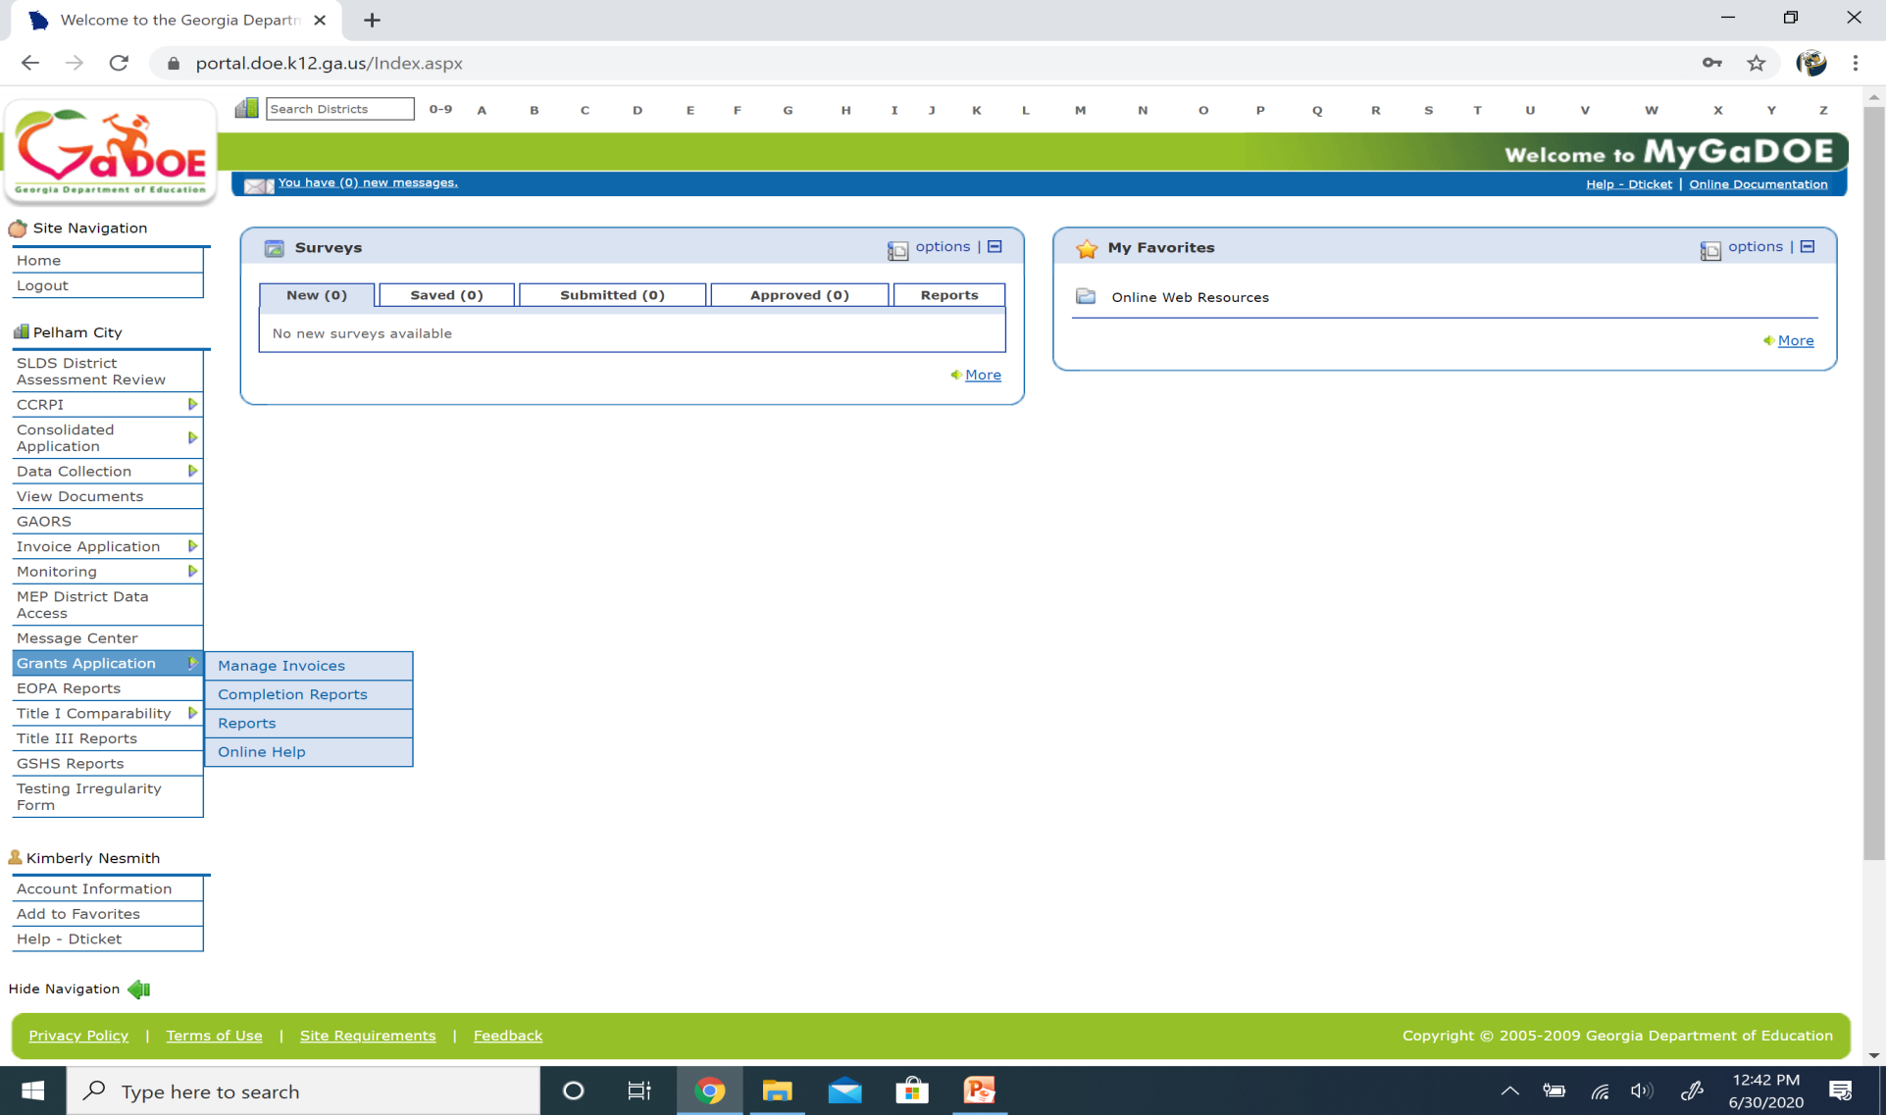
Step 2: Access the Grants Application within the MyGaDOE Portal (portal.doe.k12.ga.us)
If you don’t have Grants Application as a menu item, you’ll need to have your district’s portal security person request access for you from GaDOE. (This is probably your Finance Director or IT Director.)

Slide 4
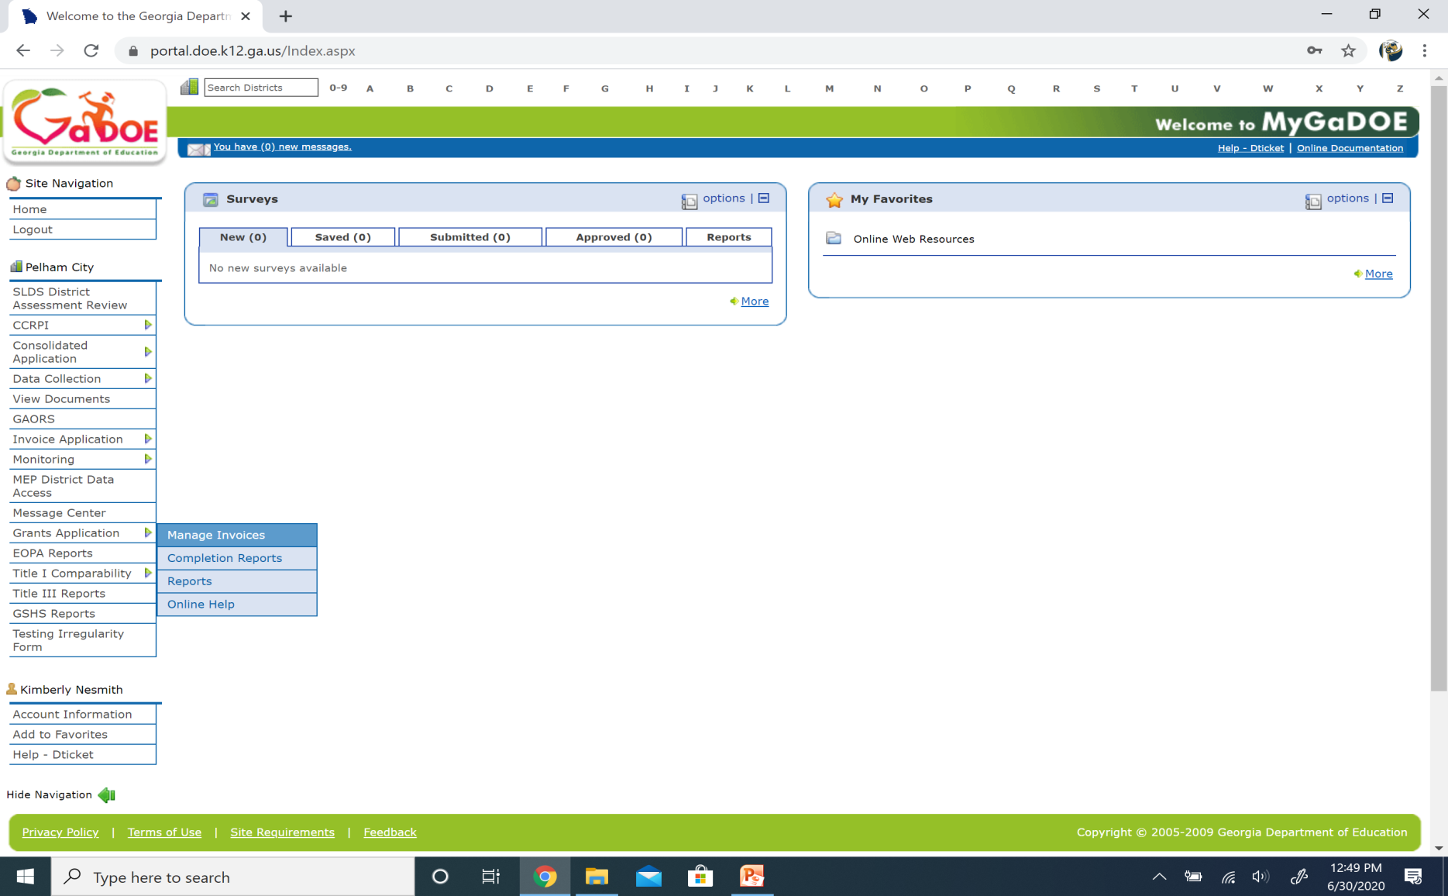
Step 3: Click Manage Invoices from Grants Application within the MyGaDOE Portal (portal.doe.k12.ga.us)

Slide 5
Step 4: Select the Fiscal Year in which the L4GA grant was initially awarded.
Note: All invoices will be submitted under the same Fiscal Year throughout the life of the grant (fiscal year initially awarded), regardless of the current Fiscal Year. Ex. Awarded in FY20, all invoices will be submitted in FY20 even in FY23.

Slide 6
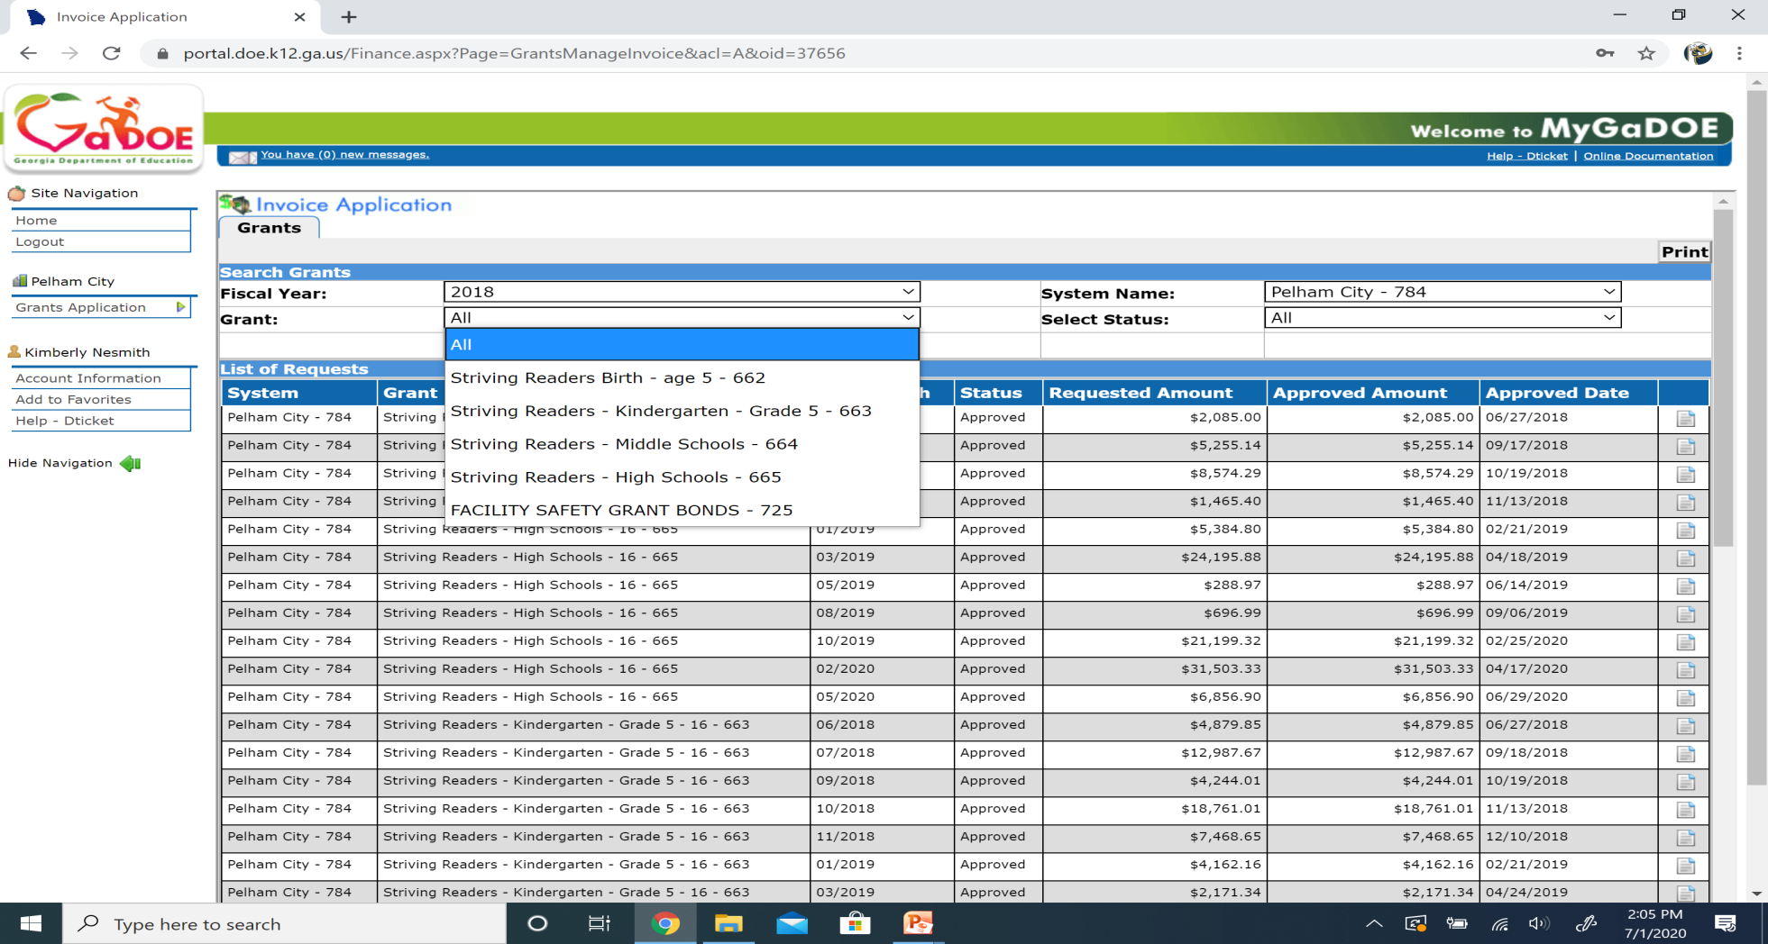
Step 5: Select the Grant (CLSD or L4GA) for which you are requesting reimbursement.
Note: Each grade band will have its own grant name.

Slide 7
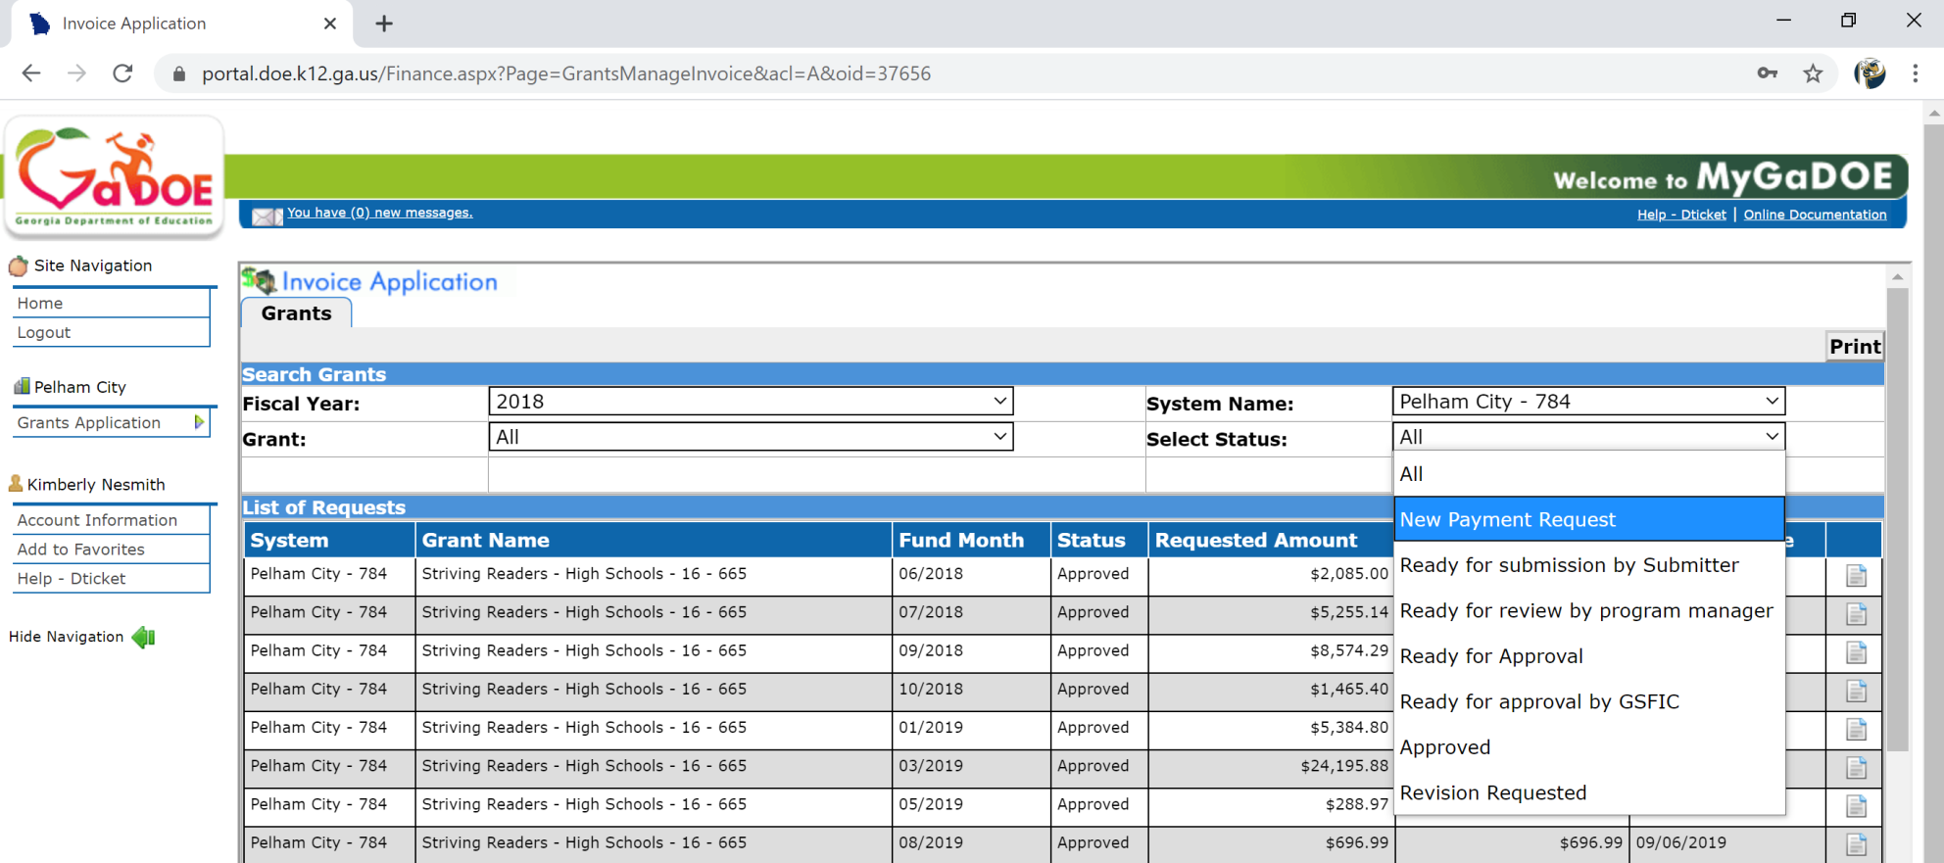
Step 6: Select New Payment Request from the Select Status drop down menu to enter a new request for reimbursement.

Slide 8
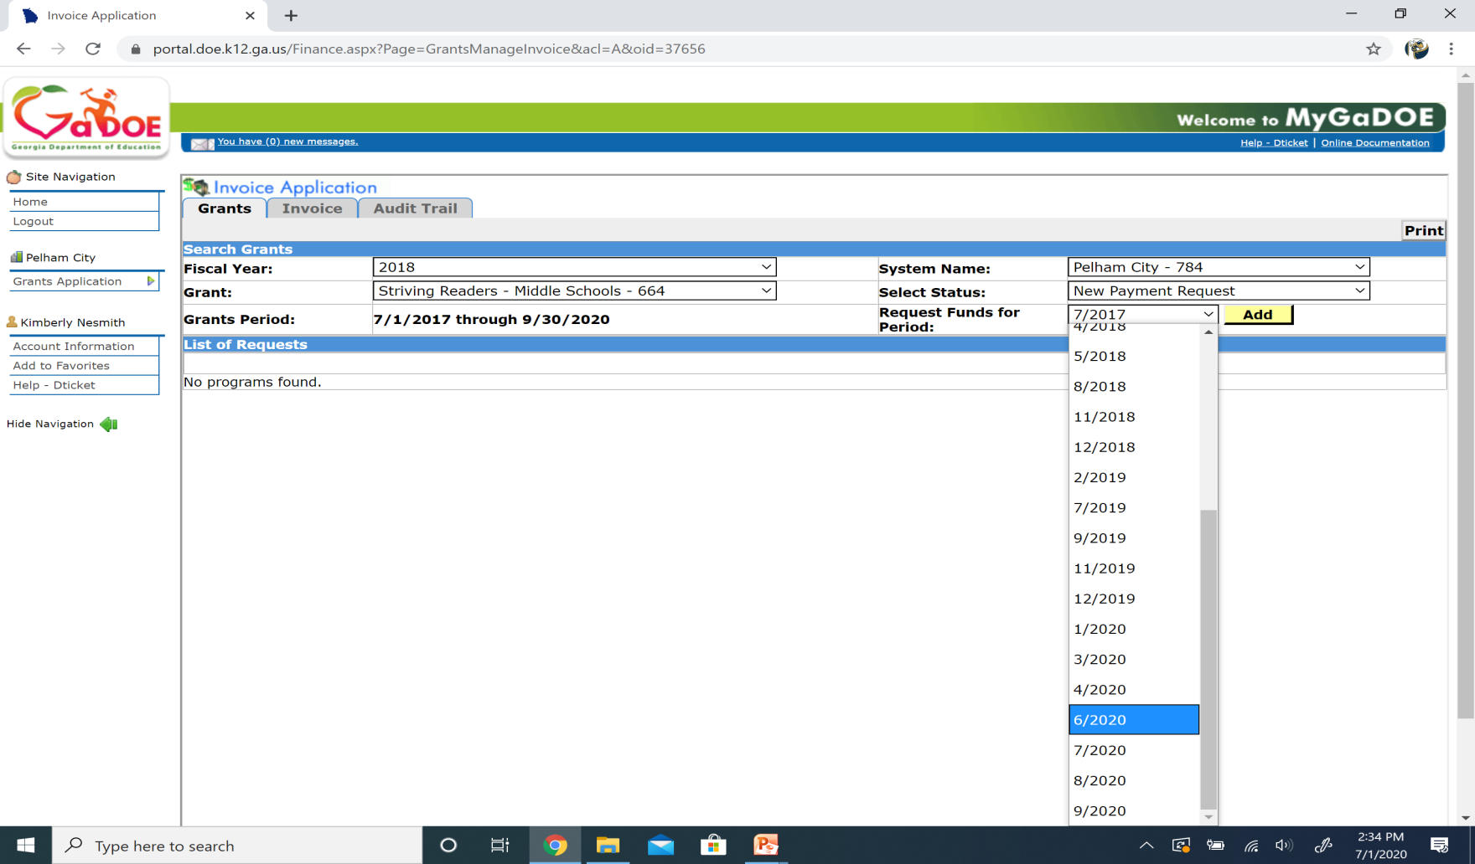
Step 7: Select the correct Month/Year for which you are requesting reimbursement under the Request Funds for Period drop down menu and click “Add.”

Slide 9
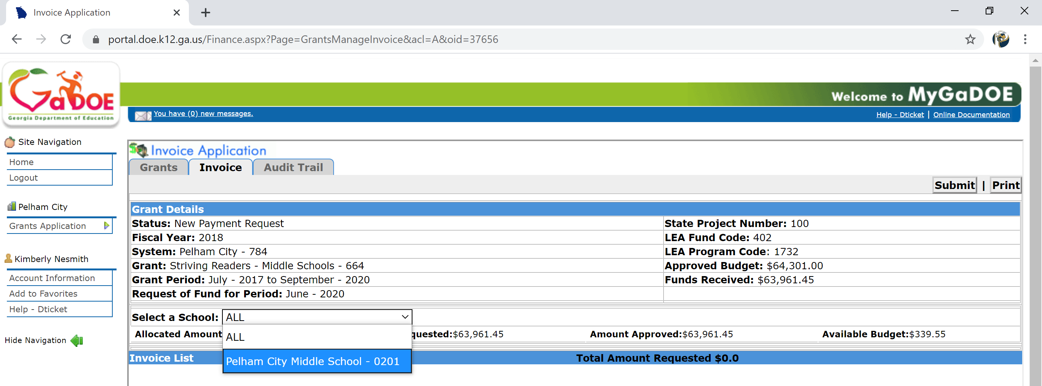
Step 8: Select the School for which you are requesting reimbursement from the Select a School drop down menu.

Slide 10
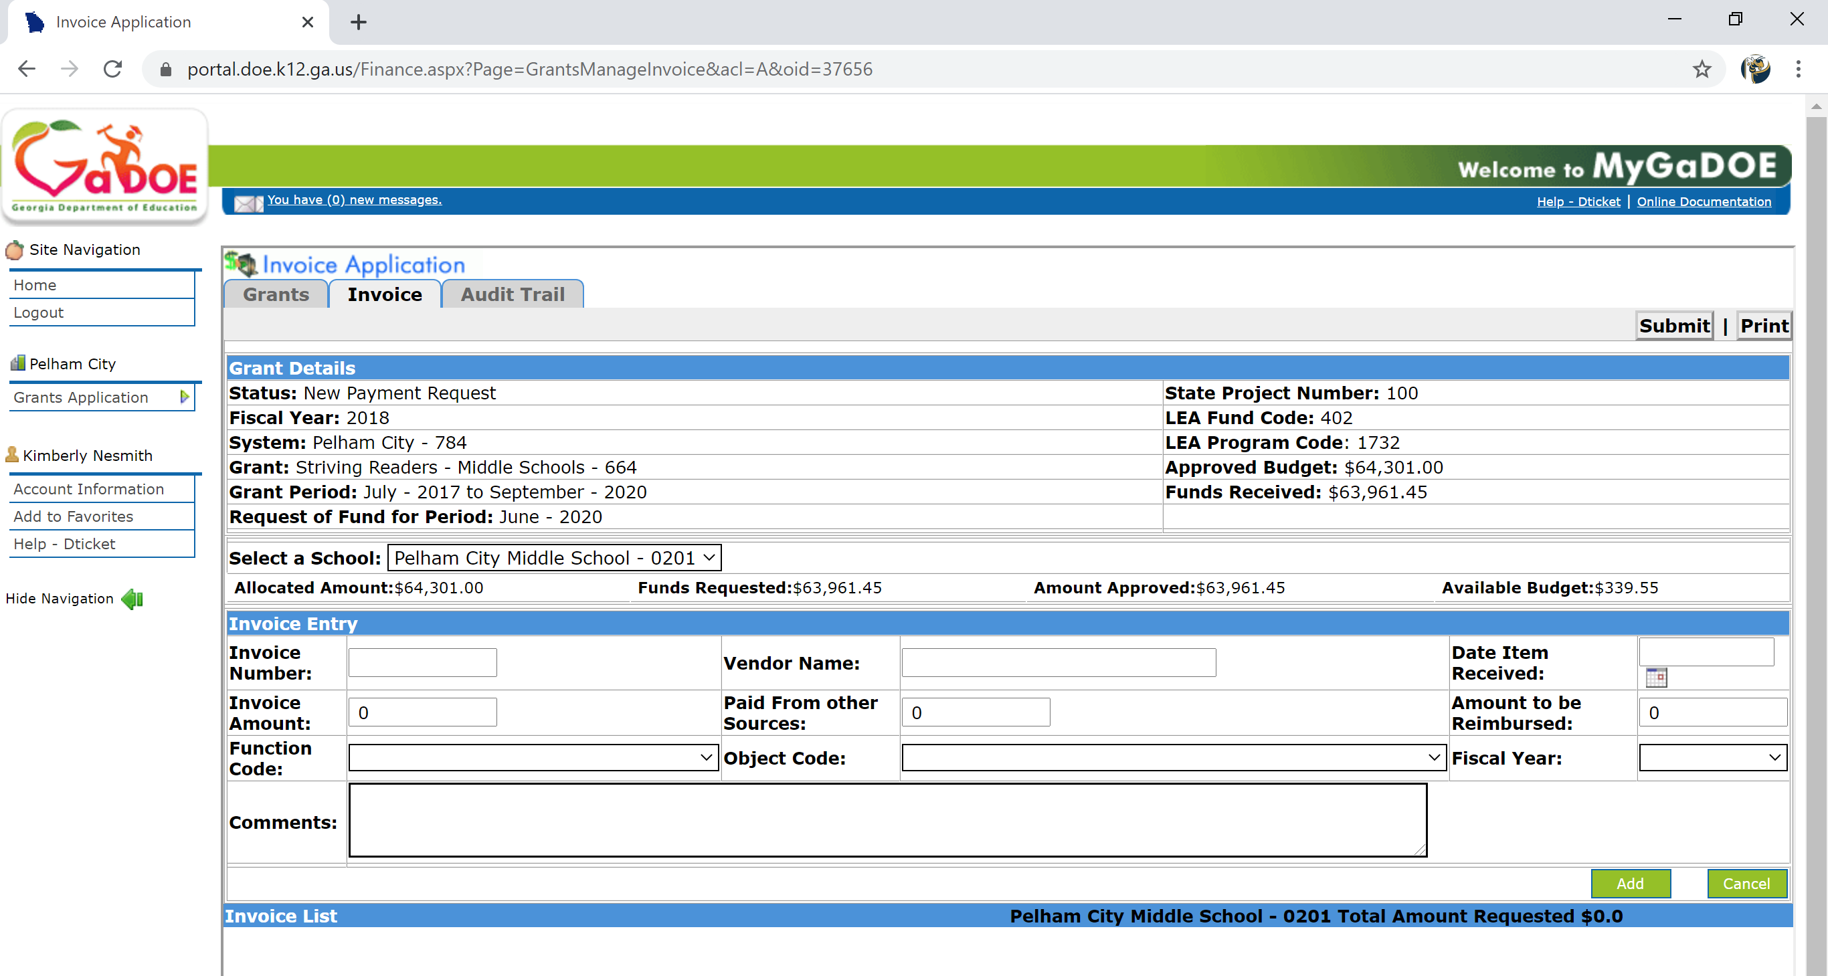
Step 9: Complete all parts under Invoice Entry and click “Add.”
Information about each Invoice Entry component is on the next slide.

Slide 11
Step 9 (Continued): Invoice Entry
Invoice Number: Number on Invoice or Check Number (if Invoice # isn’t available, Ex. Employee Travel Reimbursement doesn’t have an Invoice #)
Vendor Name: Name of Company or Individual item was purchased or funds were paid.
Invoice Amount: Total amount of invoice.
Paid from other Sources: (optional, if other funding sources were used). If documented, use total amount paid from sources other than L4GA.
Amount to be Reimbursed: Total $ requested from this school’s grant for this purchase.
Function Code: Select appropriate code as originally budgeted and paid
Object Code: Select appropriate code as originally budgeted and paid
Fiscal Year: Select the Fiscal Year of the Initial Award
Comments: Optional

Slide 12
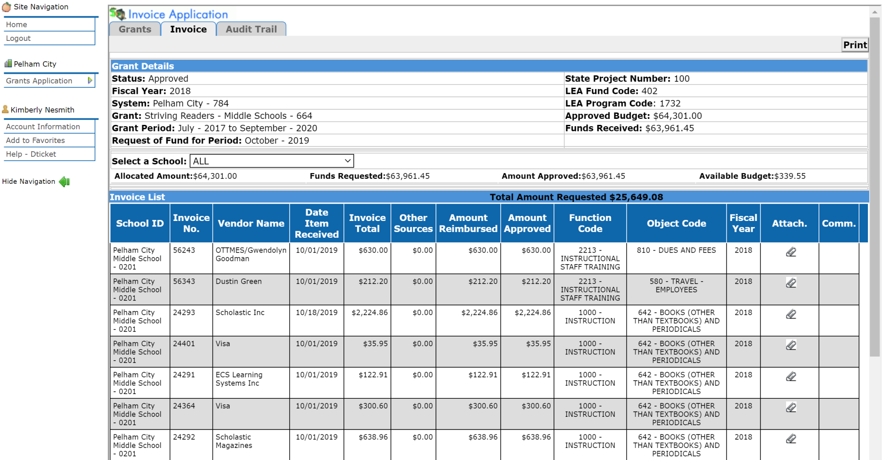
Step 9 (Continued): Repeat process (Invoice Entry → Add) until all invoices for the period have been entered.
Invoice List of all completed Invoice Entries is shown below.

Slide 13
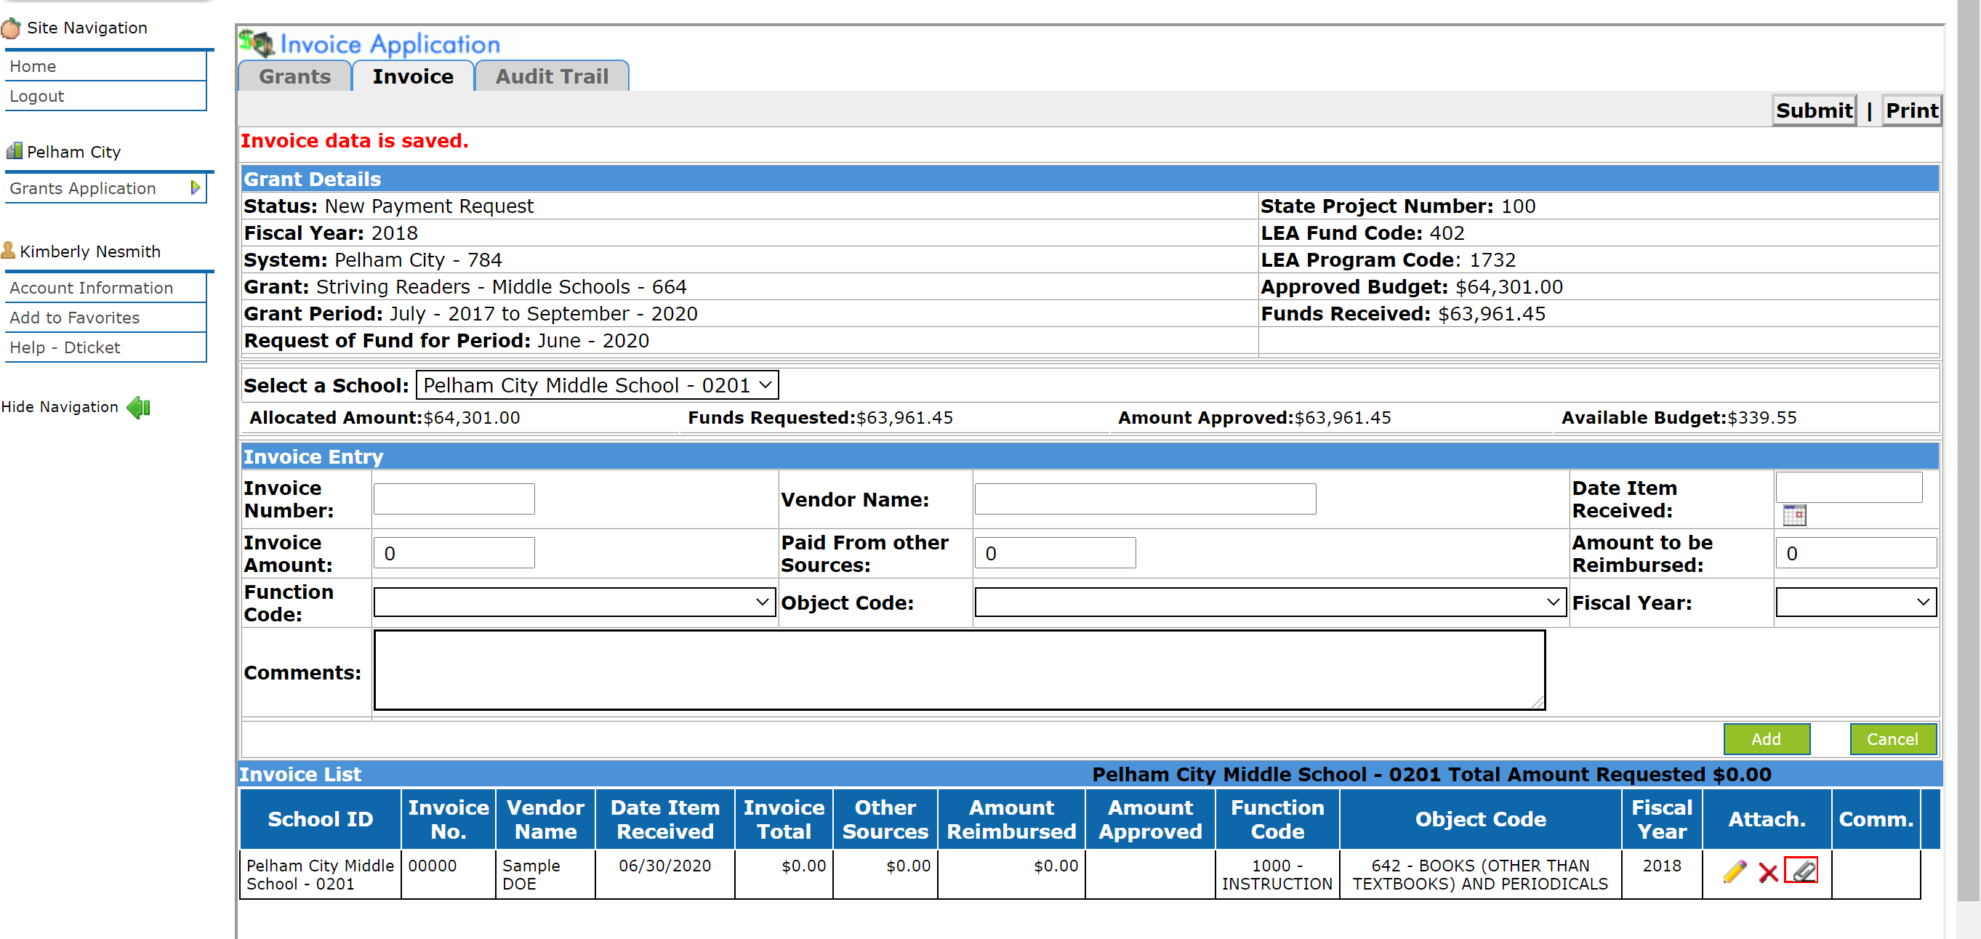
Step 10: Scan and upload Invoice and Supporting Documentation. Begin upload process by clicking on the paper clip under Attach.
We include PO, Invoice, Check, and any other supporting documentation (ex. Agenda).
Note: If you need to edit or delete information from the Invoice Entry, click on the Pencil (edit) or to delete.

Slide 14
Step 10 (Continued): Upload File by clicking Choose File, selecting correct file, and clicking Upload.
Upon successful upload, you will see screen below:
To delete or download attachment.

Slide 15
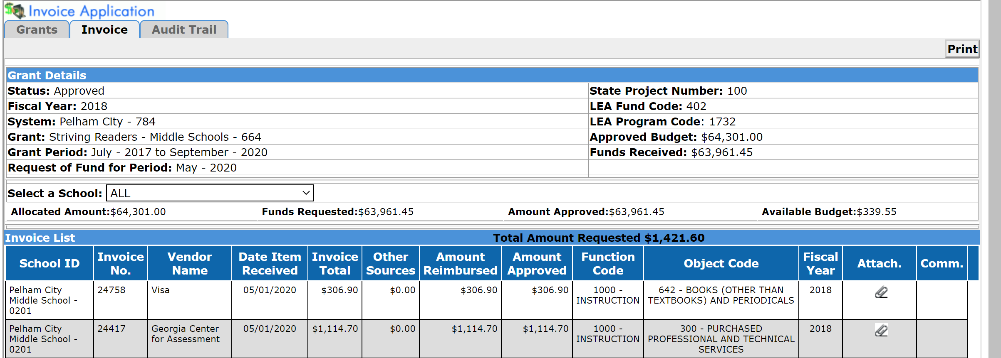
Step 11: Once all invoices have been entered and documentation attached, verify amounts.
Total Amount Requested: Total of all Invoices requested for reimbursement for this period
Allocated Amount: Amount awarded in Grant
Funds Requested: Total of all funds previously requested for reimbursement
Amount Approved: Total of all funds previously approved for reimbursement
Available Budget: Remaining budget available for reimbursement (Allocated Amount-Funds Requested)
$64,301.00 - $63,961.45 = $339.55
$306.90 + $1,114.70 =$1,421.60

Slide 16
Step 12: Once all invoices have been entered, documentation attached, and amounts verified, click Submit.

Slide 17
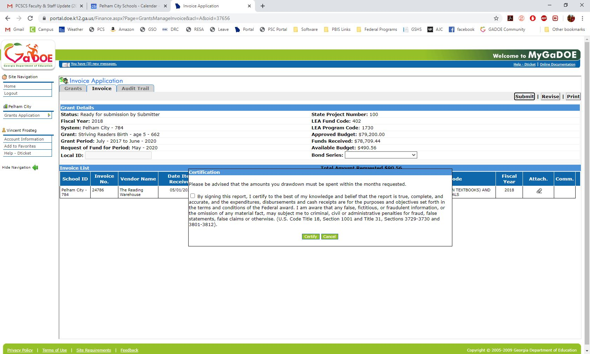
Step 12 (Continued): Once submitted, you will be asked to certify that the report is accurate to the best of your knowledge. Check the box and click Certify.

Slide 18
Step 13: Click Audit Trail to follow the status from submission to approval.
Completed Process

Slide 19
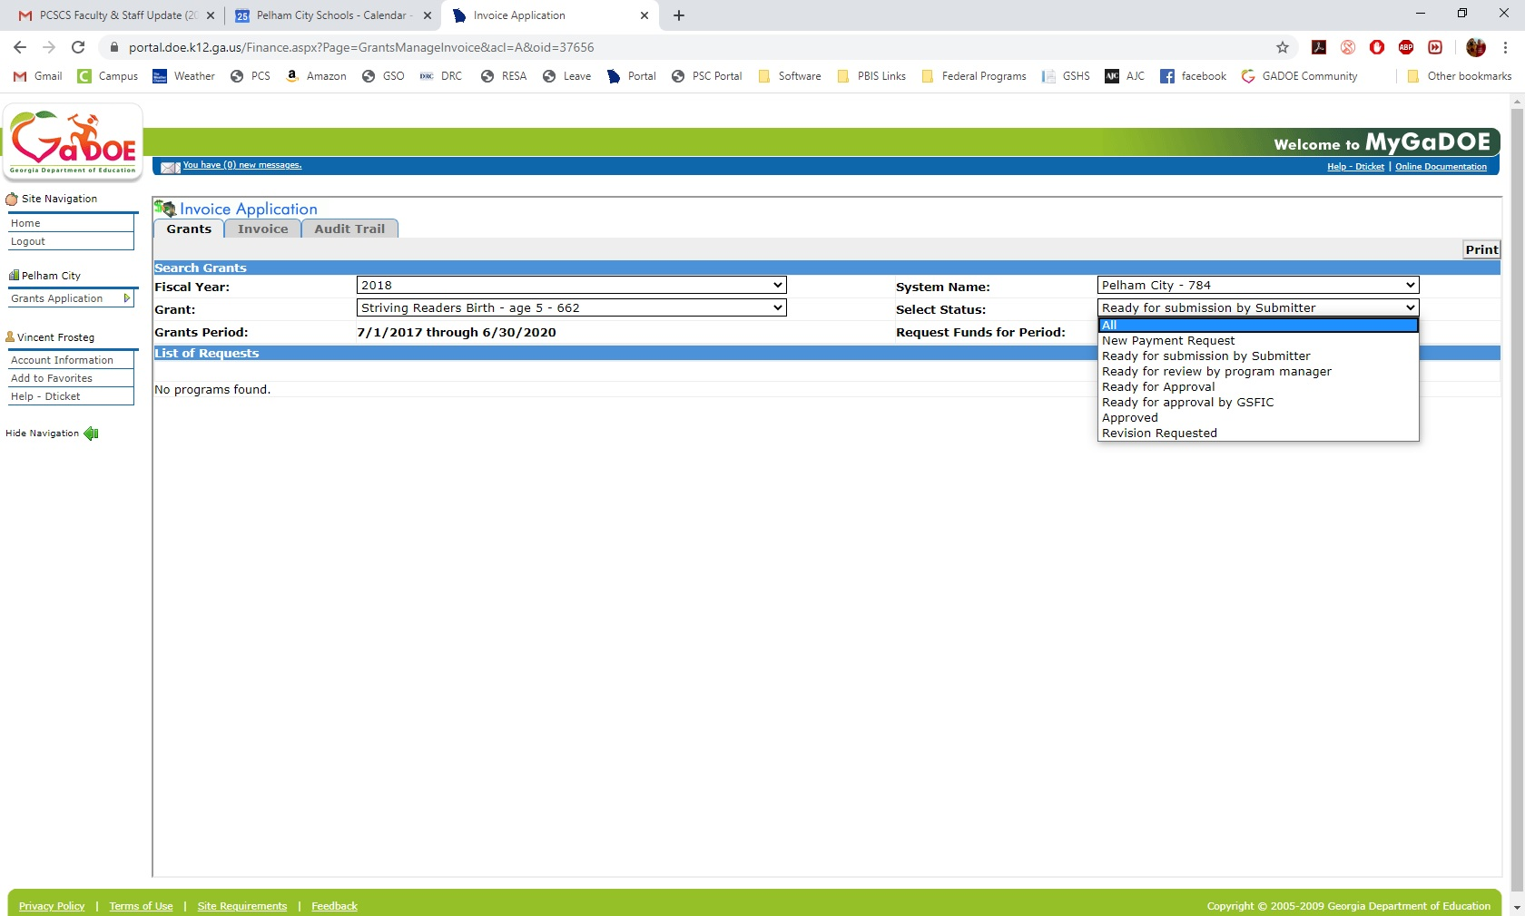
Follow Up: In order to see what’s waiting for you to sign off on or to view previously submitted requests, you’ll need to change the “Select Status” to “All”.

Slide 20
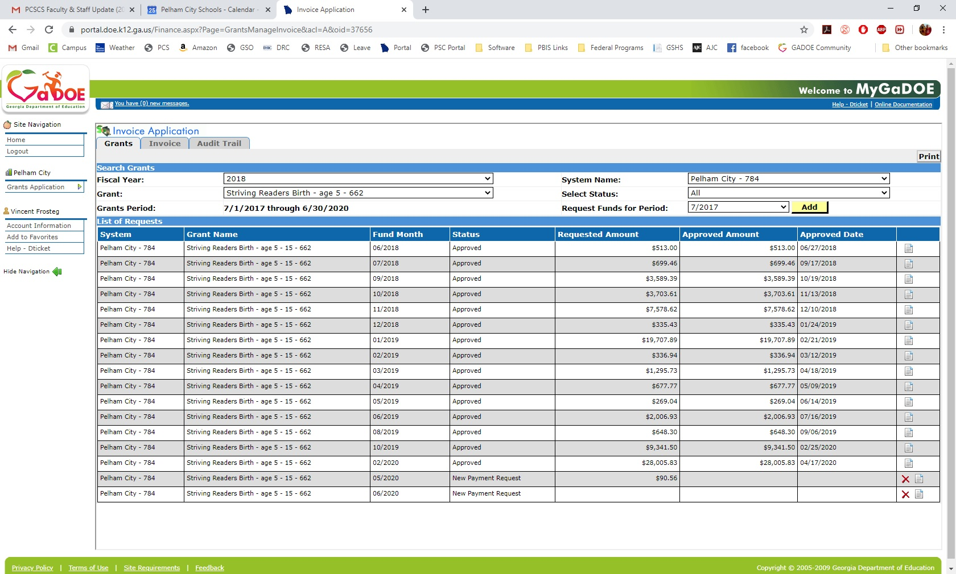
This brings up all the reimbursements that have been approved, as well as any that are waiting for you to complete/submit. You’ll want to click on the “view” icon of the period you’re going to edit or approve (You can also delete, if not approved).

Slide 21
Reimbursement/Grant Management Tips
Scan and enter source documentation (PO, Invoice, Check, etc.) into the Invoice Application at the time of payment (name scanned files in a systematic manner in order to easily find file, if needed)
Maintain a spreadsheet with budgets and expenses for each school’s grant
Update spreadsheet at time of purchase (when PO is submitted)
Reconcile monthly and cumulative reports from accounting software with budget spreadsheet monthly
Use accounting reports to verify Invoice Entry data for each reimbursement period
Triple check calculations to verify amount of expenses, reimbursements requested, and remaining balances
Once ready for approval, check amounts and attachments again before signing off

